Slide 1
Membrane Air Separation
Group 1
Joshua Olusoji, Omar Zaruk, Sanad Abu Hweij, Qussay Suleiman
Chemical Engineering Lab I
11/25/2025

Slide 2
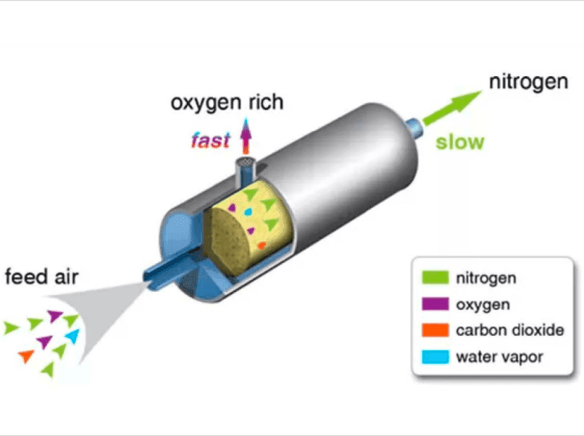
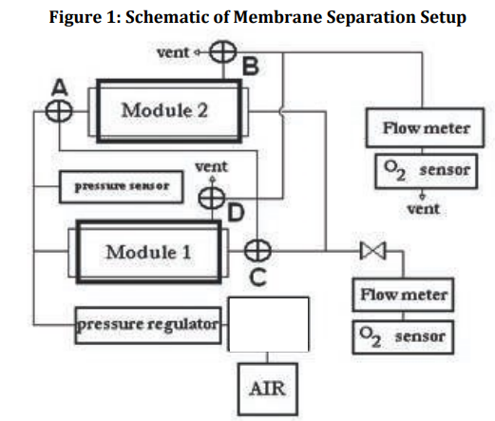
Introduction
Membrane Separation
Thousands of bundled, hollow tubes allow fast flow of oxygen & slow flow of nitrogen.
Cheaper than liquefaction & evaporation!
Studied pressure, flowrate, and configuration effects on separation efficiency.
Used in purification, filtration, and electrolyte recycling.

Slide 3
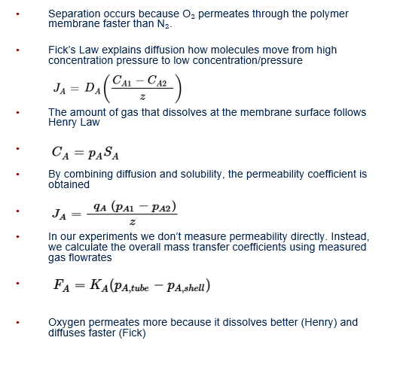
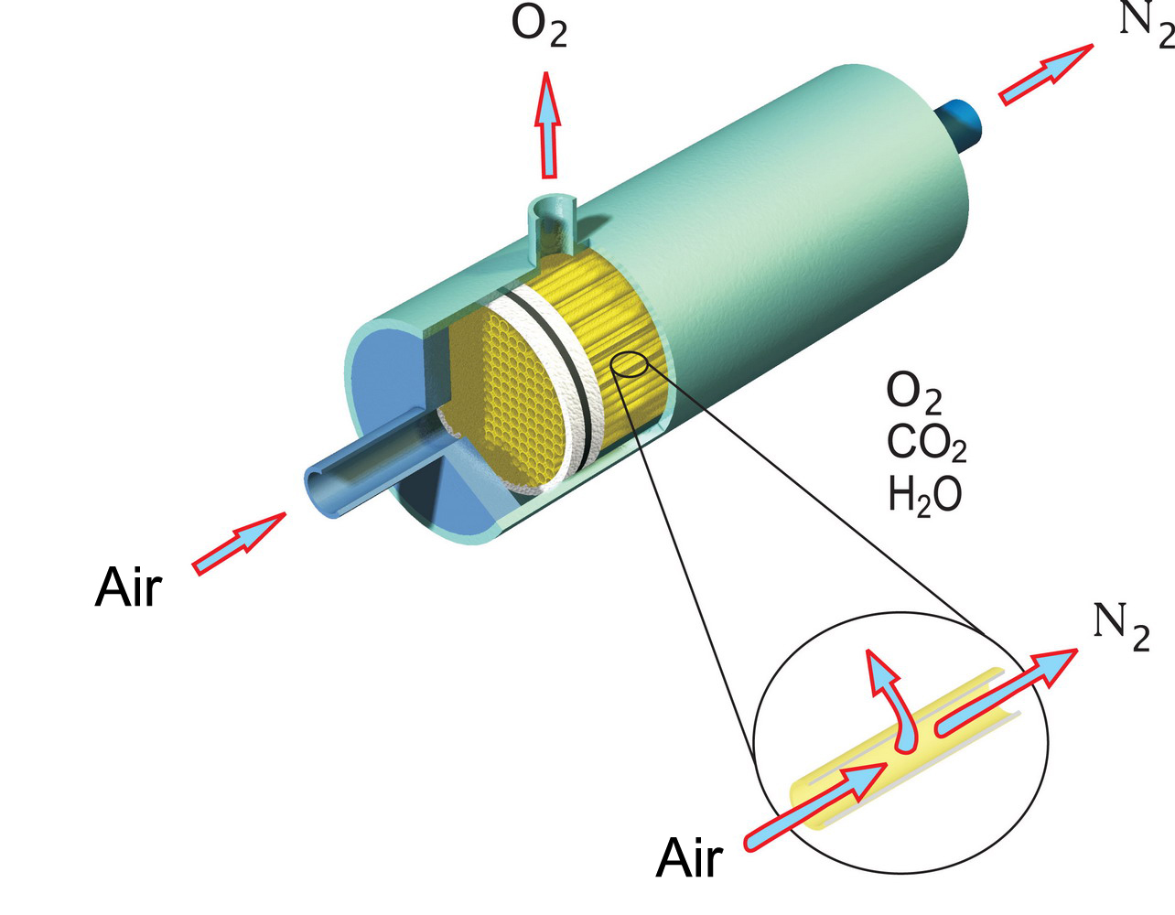
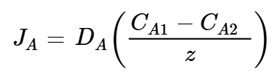



Theory
Separation occurs because O₂ permeates through the polymer membrane faster than N₂.
Fick’s Law explains diffusion how molecules move from high concentration pressure to low concentration/pressure
The amount of gas that dissolves at the membrane surface follows Henry Law
By combining diffusion and solubility, the permeability coefficient is obtained
In our experiments we don’t measure permeability directly. Instead, we calculate the overall mass transfer coefficients using measured gas flowrates
Oxygen permeates more because it dissolves better (Henry) and diffuses faster (Fick)
Technology.” GPCTEK Co., Ltd., https://gpctek.com.sg/technology/. Accessed 25 Nov. 2025

Slide 4
Experimental Objective
The objective of this experiment is to investigate the pressure-driven separation of oxygen and nitrogen using a two-module hollow-fiber membrane unit. By measuring flow rates, gas compositions, and operating pressures, the experiment evaluates how these variables affect permeation behavior, transport coefficients, and overall separation performance.
The experiment also compares series and parallel flow configurations to determine how module arrangement influences gas recovery and separation efficiency. Analysis of permeate and retentate compositions under varying conditions provides insight into membrane selectivity and system behavior.

Slide 5
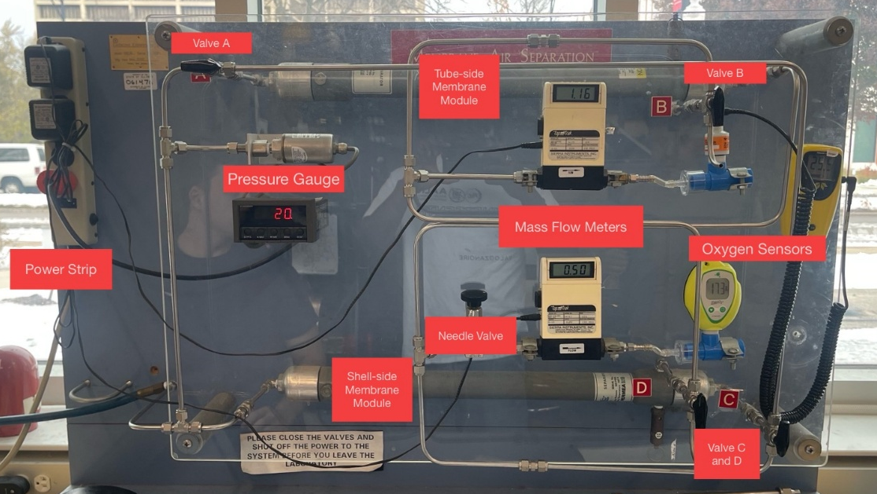
Apparatus

Slide 6
Procedure
Calibrate portable O₂ sensors to ambient air (20.9% O₂).
Select the module configuration: Parallel = A-Left, B-Up, C-Down, D-Up; Series = A-Right, B-Up, C-Up, D-Up.
Set the operating pressure by opening the cylinder valve and adjusting the regulator (20, 40, 80 psig).
Adjust the needle valve to reach the desired tube-side flowrate (0.5, 1, 2, 4, or 8 SLPM) and wait 1–3 minutes for readings to stabilize.
Record the steady-state tube-side pressure and flowrate, the tube-side and shell-side O₂ mole fractions, the shell-side flowrate, and the configuration used.
Perform runs for all combinations of pressure and flowrate in both parallel and series configurations.
After completing all runs, slowly depressurize the system, then shut off the cylinder valve and all instruments.

Slide 7
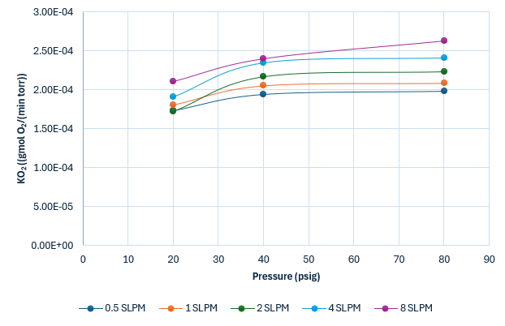
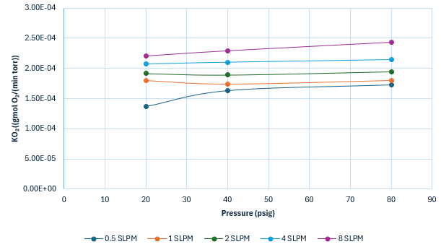
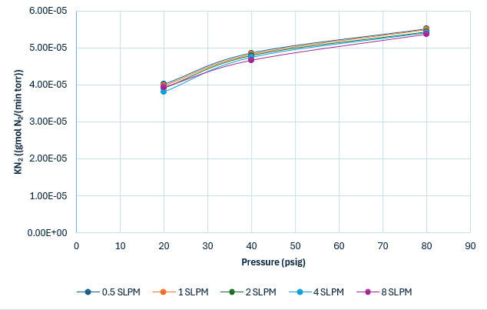
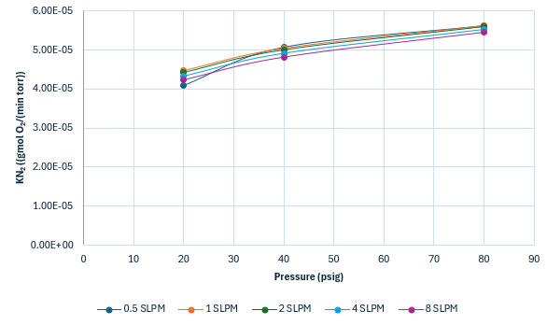
Results - Transport Coefficients
Series
Parallel
Data & Trends
O₂ Transport:
Increases with pressure for all flowrates.
Slightly higher at larger flowrates.
Levels off at higher pressures.
Slightly higher in series than in parallel.
N₂ Transport:
Increases slightly with pressure (much less than O₂).
Shows minimal dependence on flowrate.
Much lower overall magnitude than O₂ due to lower membrane selectivity.
Series and parallel give nearly identical trends.
Notes:
O₂ Transport coefficients are much higher than N₂ Transport coefficients (by an order of magnitude) because the membrane has much lower permeability to nitrogen. Thus, N2 barely permeates and thus has much less transport and isn’t dependent on pressure and flow as much.
Transport coefficients are functions of the permeation rate and the partial pressure of the species.

Slide 8
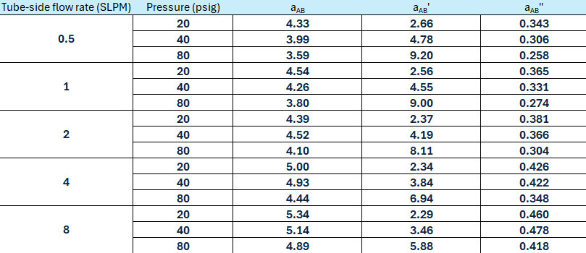
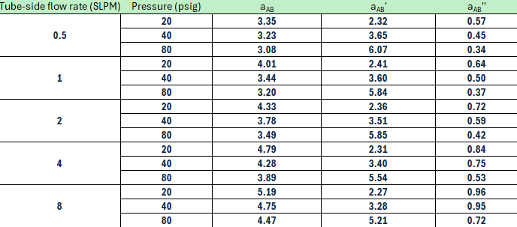
Results - Separation Coefficients
Data & Trends
a_{AB} (Permeate-based): Decreases with pressure and rises slightly with flowrate
a_{AB}’ (Retentate-based): Increases with pressure and decreases slightly with flowrate
a_{AB}’’ (Feed-based): Strongly increases with flowrate in both configurations and shows weaker pressure dependence
Notes:
a_{AB:} Compares how enriched the permeate is in O₂ relative to the feed. Series is higher because the full feed passes through two modules instead of splitting, where each module only sees half the feed..
a_{AB}’ :Measures how depleted the retentate is in O₂ relative to the feed. Series is higher because sequential modules strip more O₂, leaving a more N₂-rich retentate.
a_{AB}’’ : Measures membrane selectivity considering the entire inlet stream. Series is higher because the feed experiences a stronger overall separation before exiting.

Slide 9
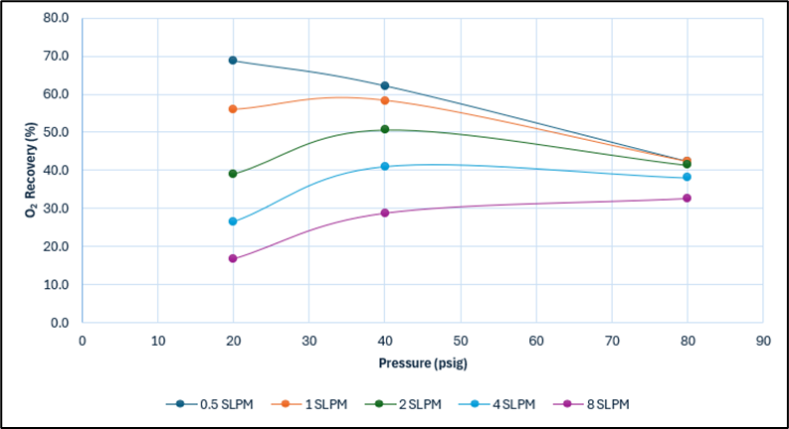
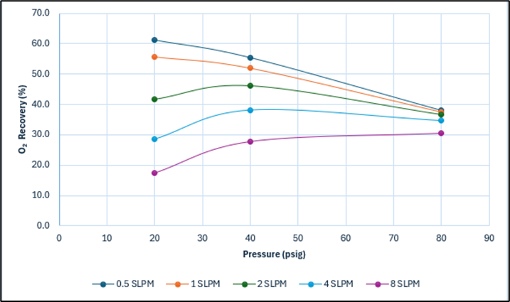
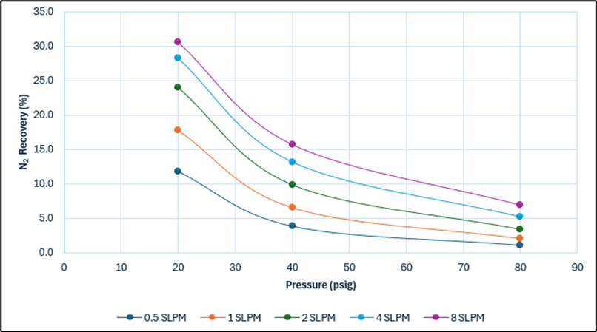
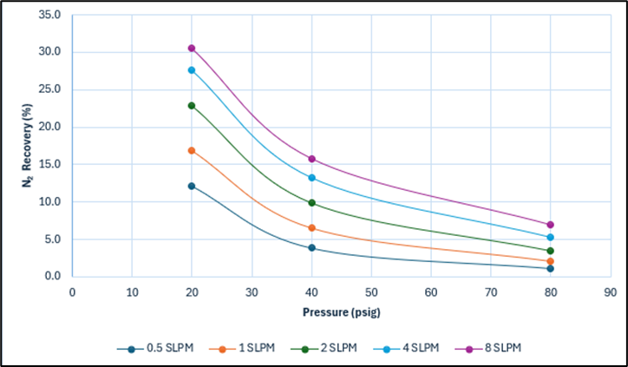
Results - Transport Recoveries
Series
Parallel
Data & Trends
O₂ Recovery:
Decreases with increasing pressure.
Highest at low flowrates (0.5–1 SLPM).
Drops at high flow due to large retentate flow.
Series gives slightly higher O₂ recovery than parallel.
N₂ Recovery:
Highest at low pressure and high flowrates.
Decreases as pressure increases.
Strong flowrate dependence; high flow gives higher N₂ recovery.
Parallel slightly higher than series due to greater retentate flow.

Slide 10
Discussion
Key Learnings
Literature Comparison
KO₂ increases with pressure, while KN₂ shows weak dependence on flowrate.
O₂ recovery is highest at low flowrates and decreases with pressure.
N₂ recovery is highest at high flowrates and low pressure.
Series configuration enhances O₂ permeation; parallel configuration favors N₂ retention.
Selectivity (~3–5) matches the (4–5) range reported by Samarasinghe et al. (2020).
Also fits within the typical (4–8) range noted by Yong et al. (2020).
Selectivity can rise ~34% with Pluronic-compatibilized CoPCMP fillers (MMM membranes).

Slide 11
Conclusion
Membrane separation is cheaper and more energy-efficient than liquefaction or cryogenic distillation.
Membranes are widely used in gas purification, filtration, and electrolyte recycling.
Series and parallel configurations affect separation efficiency, with series giving slightly stronger enrichment.

